Slide 1

Optimizers from Scratch

Slide 2
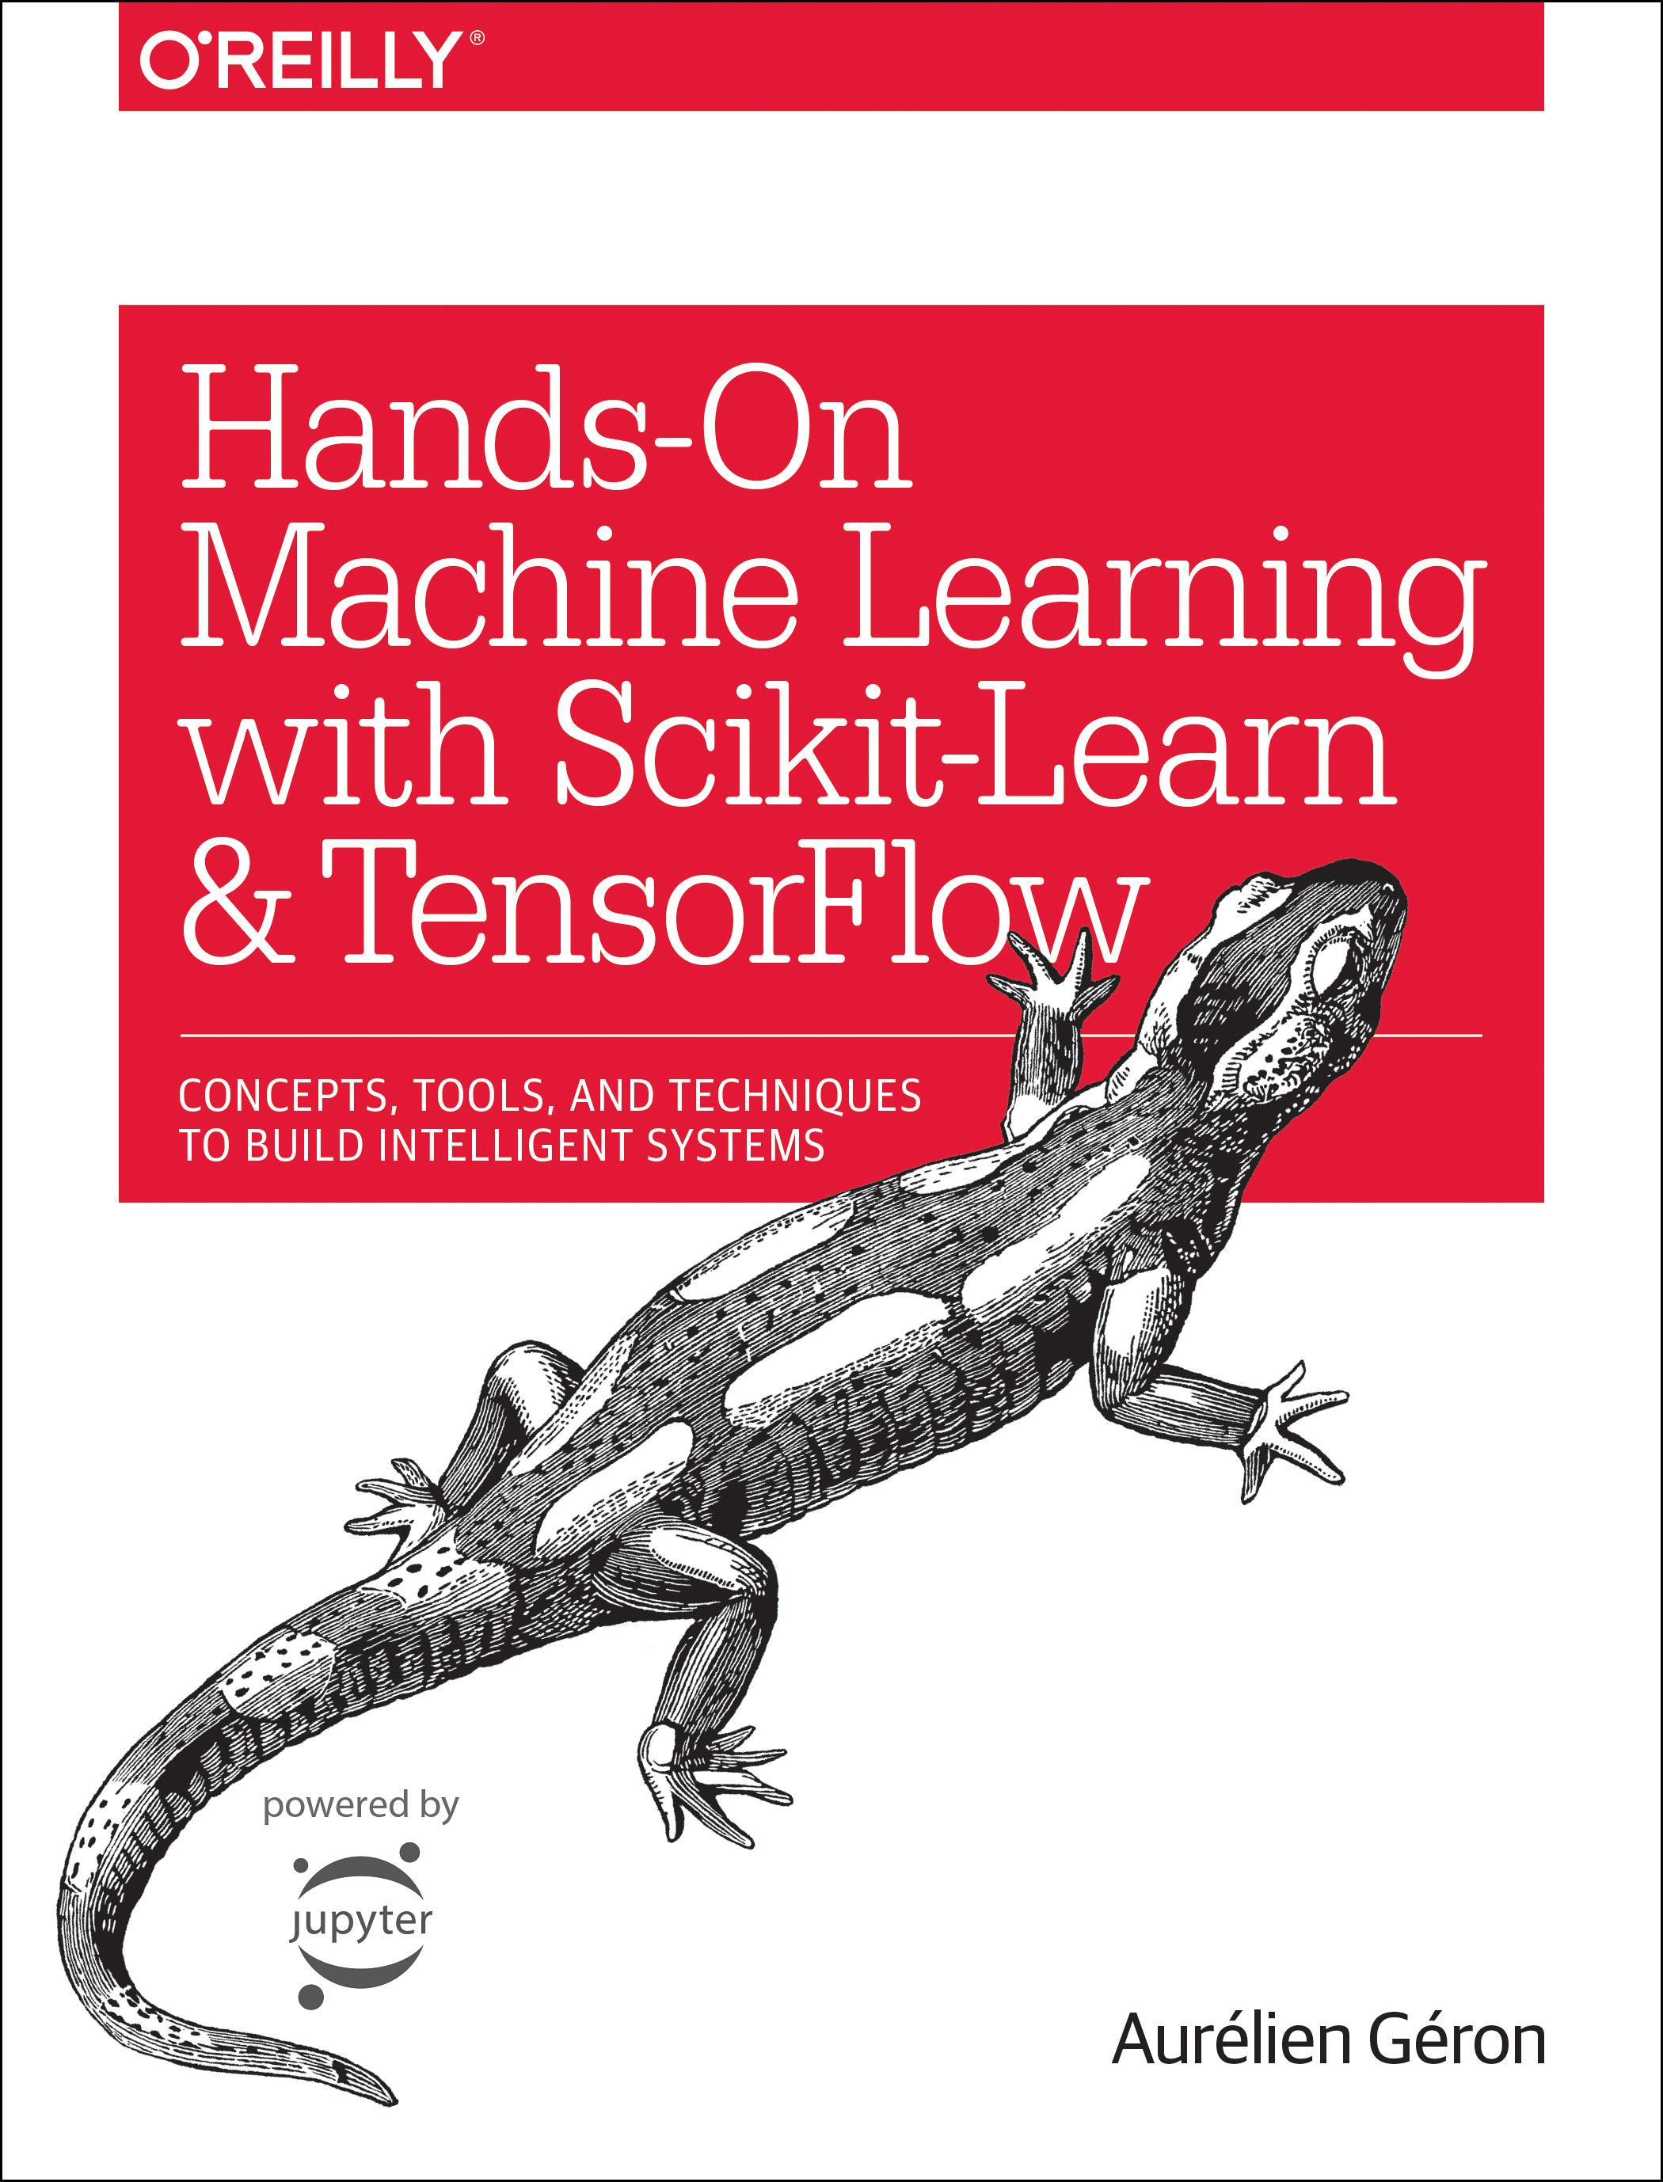
Reference
Chapter 9 (O'Reilly) of Hands-On ML
Youtube on (Manual) Gradient Descent
Youtube on (Auto) Gradient Descent
Youtube
Code

Slide 3
Data

Slide 4
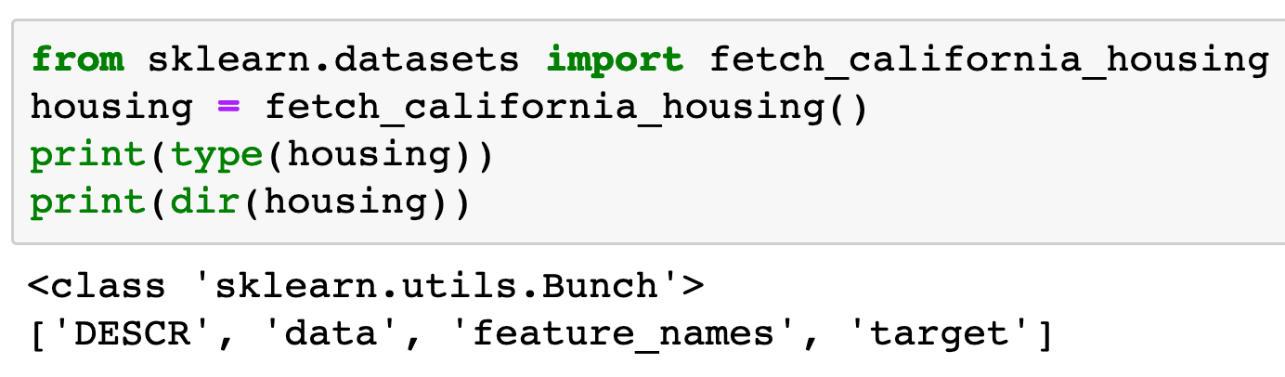

Slide 5
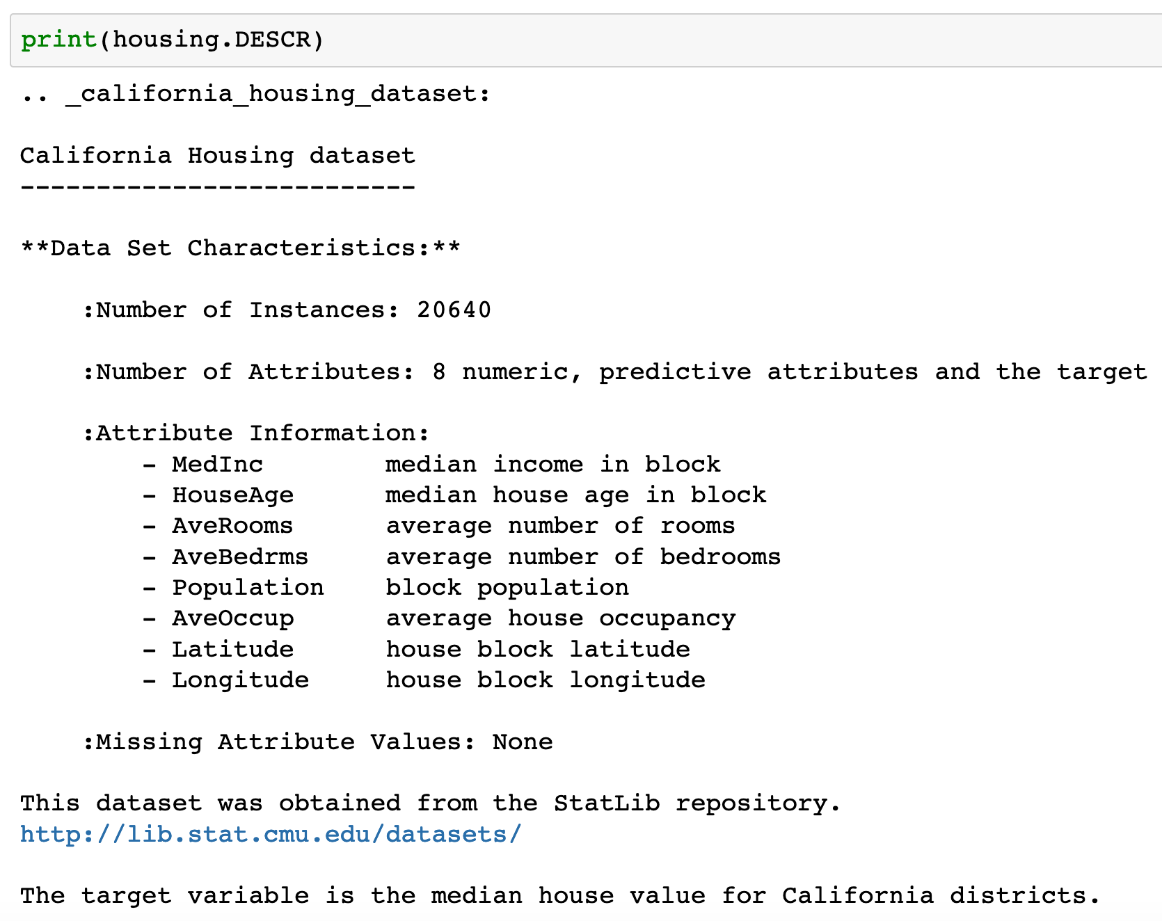

Slide 6
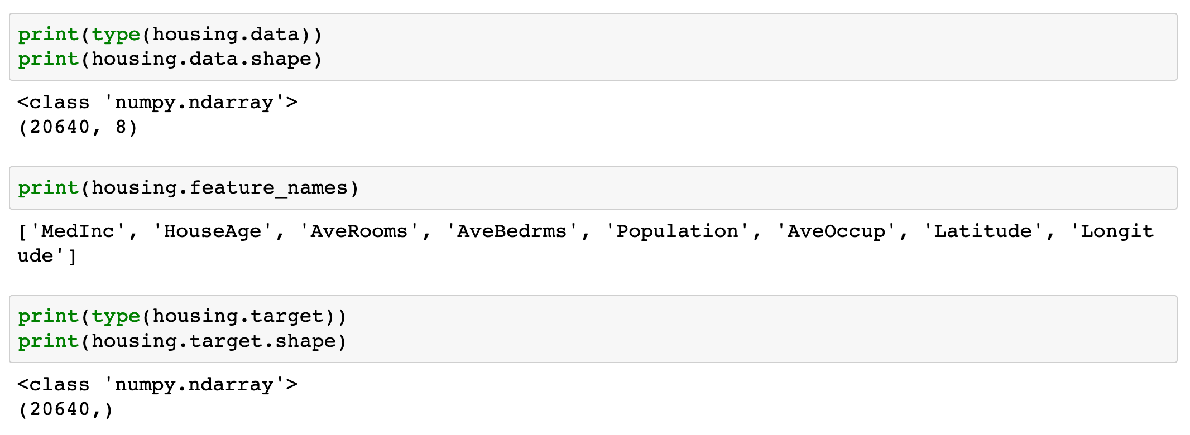

Slide 7
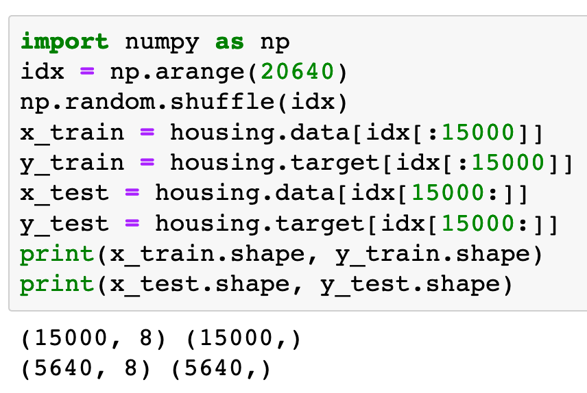

Slide 8
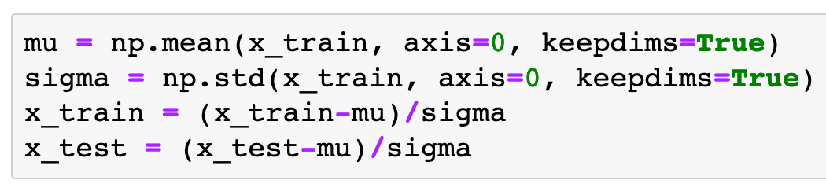
Input Normalization

Slide 9
Warm Up

Slide 10
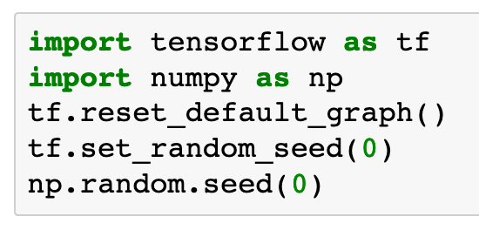

Slide 11
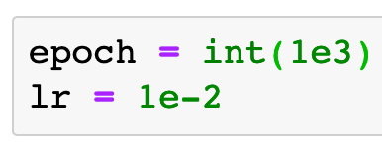

Slide 12
Graph

Slide 13
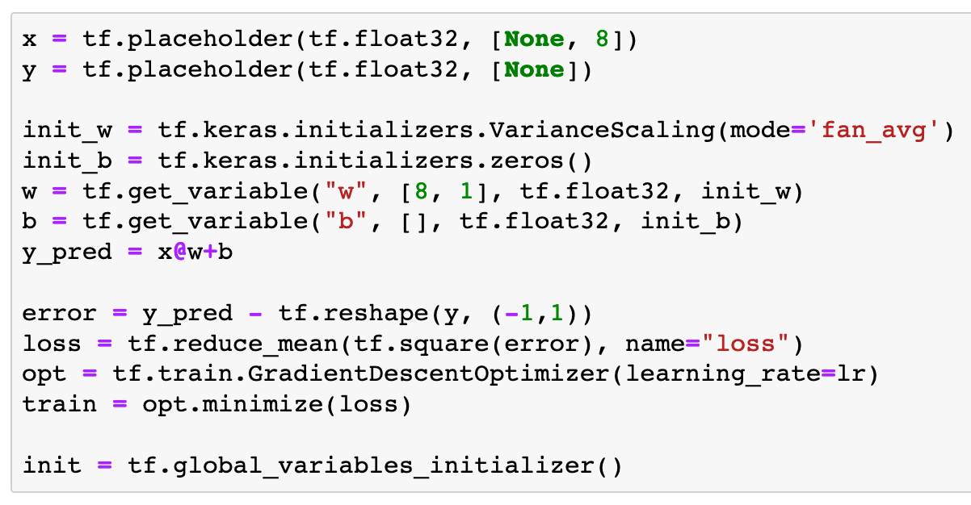
tf.train.GradientDescentOptimizer

Slide 14
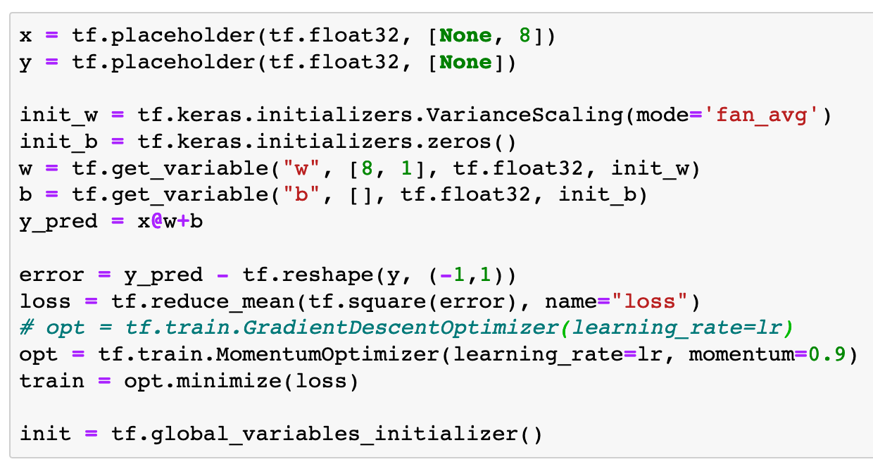
tf.train.MomentumOptimizer

Slide 15
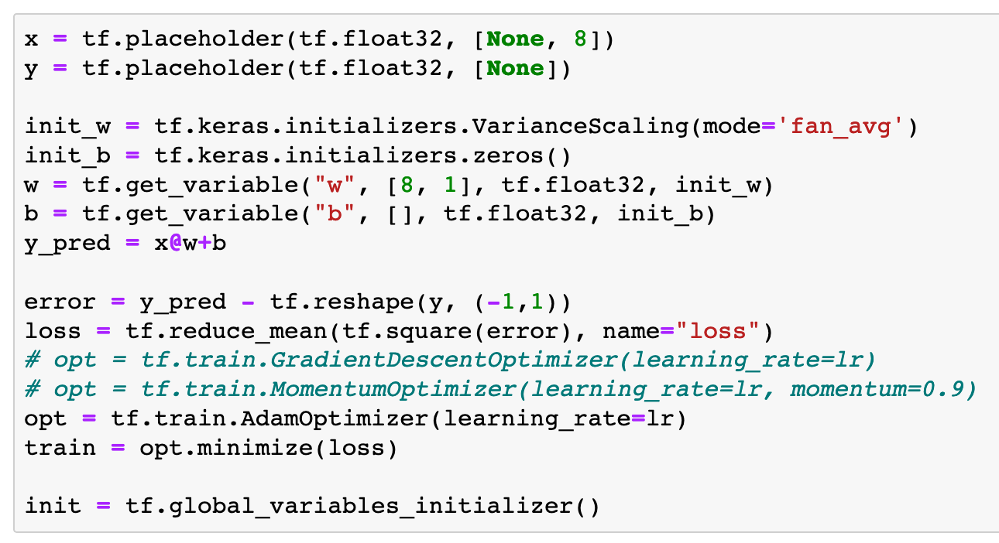
tf.train.AdamOptimizer

Slide 16
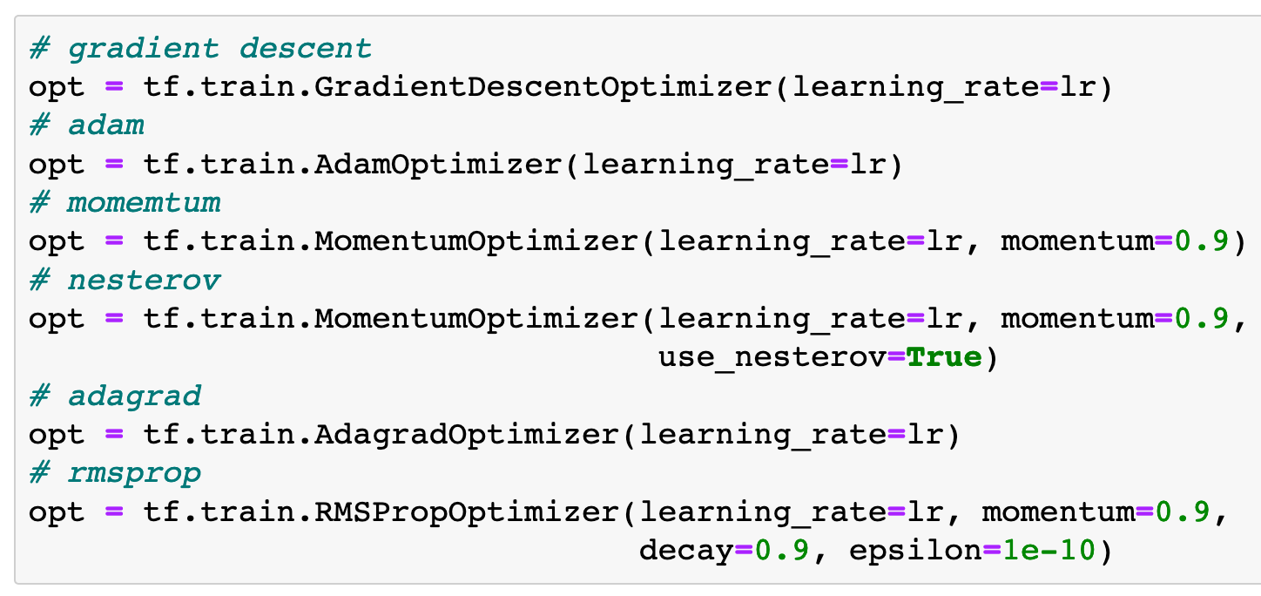
Alternatives

Slide 17
Session

Slide 18
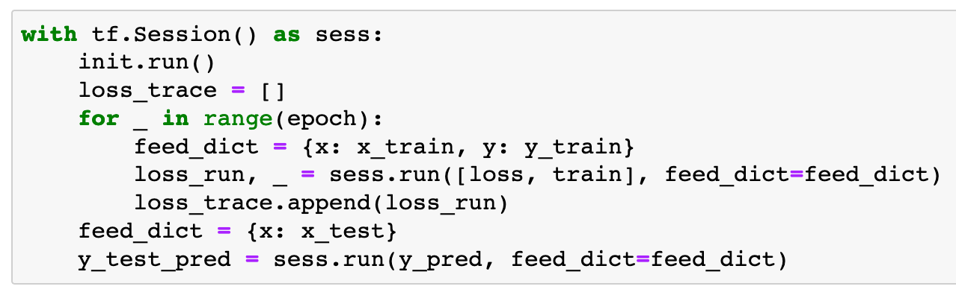

Slide 19
Report

Slide 20
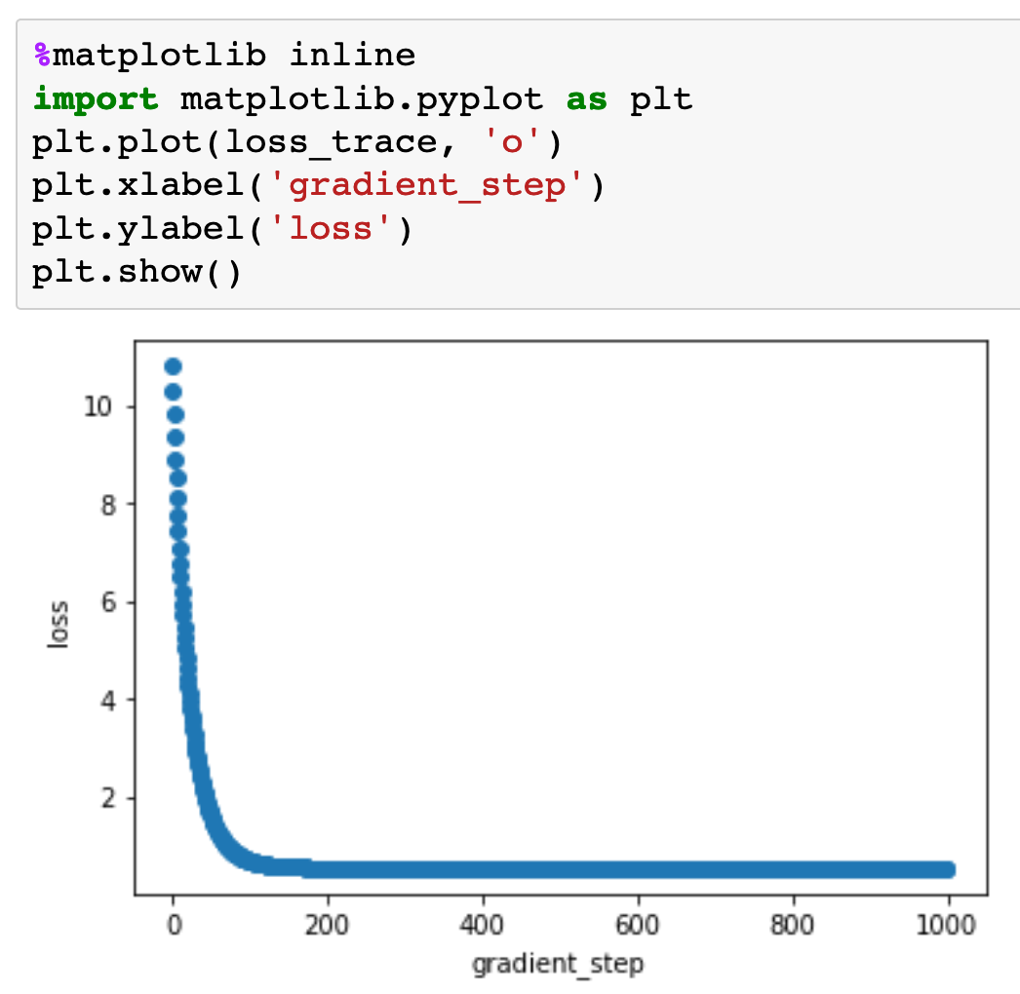

Slide 21
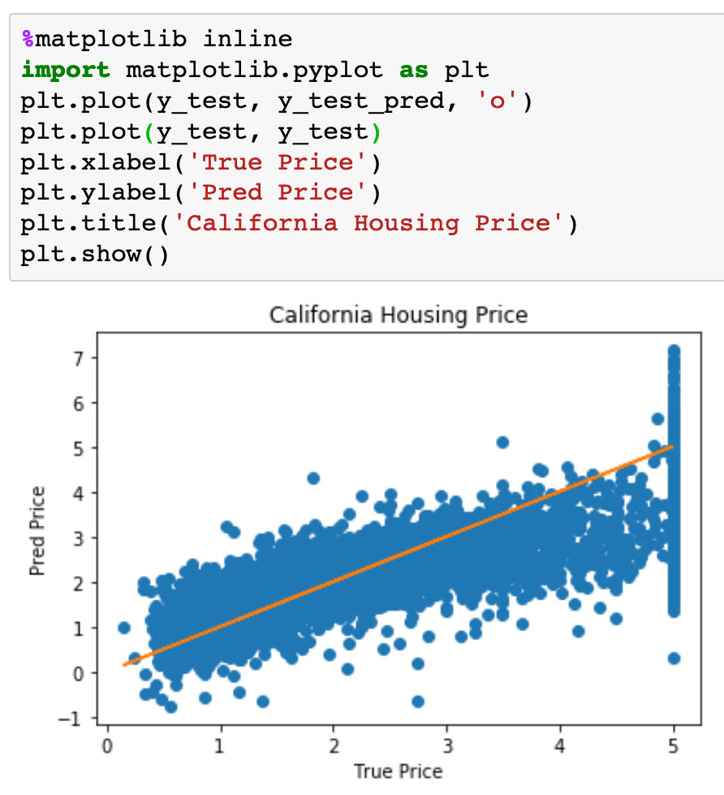

Slide 22
Now
Let’s Play with Code

